Slide 1
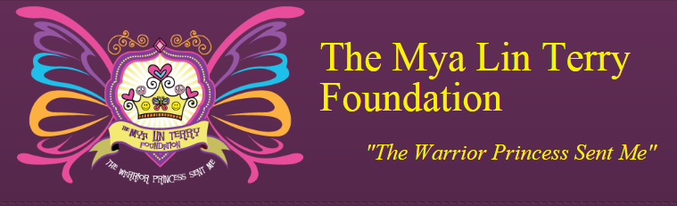


MYA LIN TERRY
AUGUST 2, 2002 – APRIL 10, 2013

Slide 2
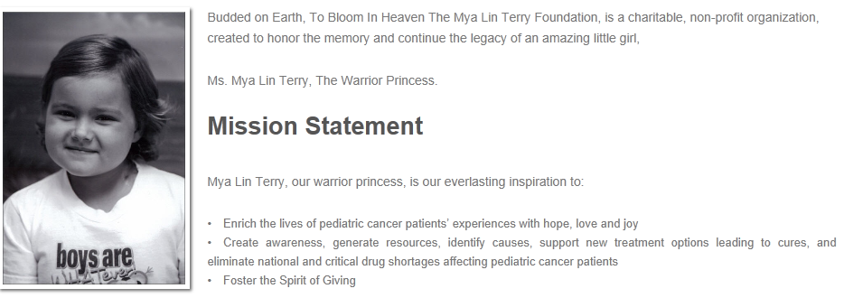
TMLTF: Our Mission

Slide 3
TMLTF: Who We Are
Foundation Officers
  Kelly L. Terry, President
  Kasey L. Pickett, Vice President
  Kenneth L. Pickett Jr., Treasurer
  Jennifer Votta, Secretary
100%
Volunteer
Board of Trustees
Bari Bradley
Bernie Hurley
Bevin Irvin
Cara Malek
Carmela Tedesco
Cate Foley
Cheri Ciano, Esq.
Christopher Roth
Colleen Esposito
Heather Vacca
Jenna Andrews
Jennifer Whalen
Jodi Savare
John Napolitani
Kimberly Vivian
Laura Mistretta
Laura Roth
Lizabeth Conti
Marni Keezer
Melissa Bennett
Melissa Ercolino
Michele Talarico
Nicole Cernigliaro
Noelle Mains
Patricia Irvin
Patricia Roth
Rich VanWagner, Esq.
Robert Heugle, Esq
Roxann Andrus
Sharon Irvin
Stacie Harkavy

Slide 4
TMLTF: Who We Are
Junior Board
Alex Pickett
Andrew Worthington
Anthony Tedesco
Bette Bradley
Catrina Kipnis
Christian Foley
Christian Votta
Christopher Vivian
Gabriella Hagerman
Hannah Mains
Holden Glazer
Jake Talarico
Jake Votta
Jenna Loeser
Jilian Roebuck
Jolie Harkavy
Kathryn DeBoe
Kendyl Vivian
Kenny Pickett
Lauren Spellman Madison Andrews
Maria Tedesco
Michael L. Terry
Morgan Spellman
Scott Bradley

Slide 5
TMLTF: Grants
Since inception, The Mya Lin Terry Foundation has been able to:
Provide $254,988.58 to ninety-six families battling pediatric cancer*
Award $8,000.00 via The Mya’s Spirit Of Giving Scholarship
Provide $40,250.00 in Research Grants to The St Jude Children's Research Hospital, Memorial Sloan Kettering Cancer Center and The University of Colorado Foundation
Issue over 1,000 Mya's Mommy Bags to families in pediatric cancer hospitals in NJ, NY, PA, TN, NC and KY
Gift numerous toys, games, crafts, DVDs, video games and art supplies to countless inpatient children in our community
Thank You, For Helping Us, Help Children!
*Does not include perpetual gifts like Mother’s Day, Father’s Day, Friends of Michael Campaign, Holiday Gifting.

Slide 6
TMLTF: How To Support
Foundation Events:
24JUN2018 Mya’s Warrior Jam and Cornhole Tournament
13OCT2018 Mya’s Run For Gold 5k
Spring2019 TMLTF Golf Outing
Donations:
PayPal: http://TheMyaLinTerryFoundation.org
Venmo: TMLTF

Slide 7
TMLTF: Awareness

Slide 8
TMLTF: Pediatric Cancer
LEUKEMIAS: Cancer of the Blood
Acute Lymphoblastic Leukemia (ALL)
Acute Mylogenous Leukemia (AML)
LYMPHOMAS: Cancer of the Immune System
Hodgkin Disease
Lymphoma (non-Hodgkin)
SOLID TUMORS: Cancer of the Bone, Organs or Tissues
Brain Tumors
Ewing Sarcoma
Germ Cell Tumors
Hepatoblastoma
Kidney/Wilms Tumor
Melanoma
Neuroblastoma
Osteosarcoma
Retinoblastoma
Rhabdomyosarcoma
Soft tissue sarcoma
Thyroid Cancer
4% of NCI funding
ACS even less
2014 NCI Budget: $4.9b – Pediatric Cancer: $195m
Prostate Cancer (1 cancer) receives more than all 13 pediatric cancers combined!

Slide 9
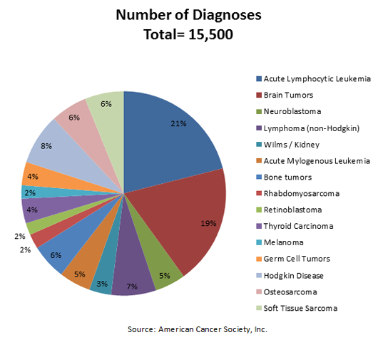
TMLTF: Pediatric Cancer
Childhood cancer remains the leading cause of death by disease among children in the United States.
Every day, 43 US children are diagnosed with cancer and the average age of diagnosis is 6.
Every day 7 US children lose their battle. 2,555 every year
Cancer affects all ethnic, gender, and socio-economic groups and more than 40,000 children undergo treatment for cancer each year.

Slide 10
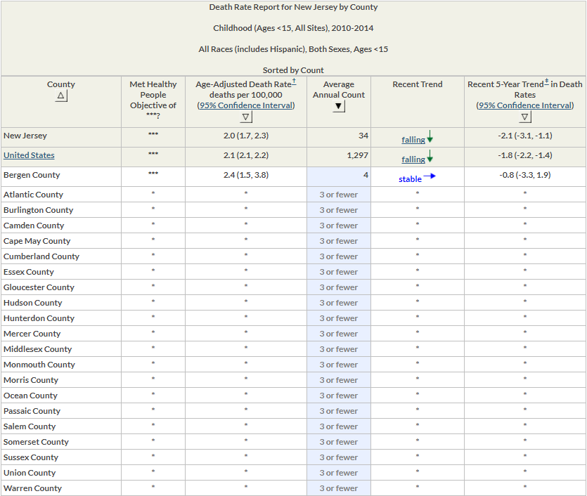
Note: Monmouth County Average Annual death rate is <3

Slide 11
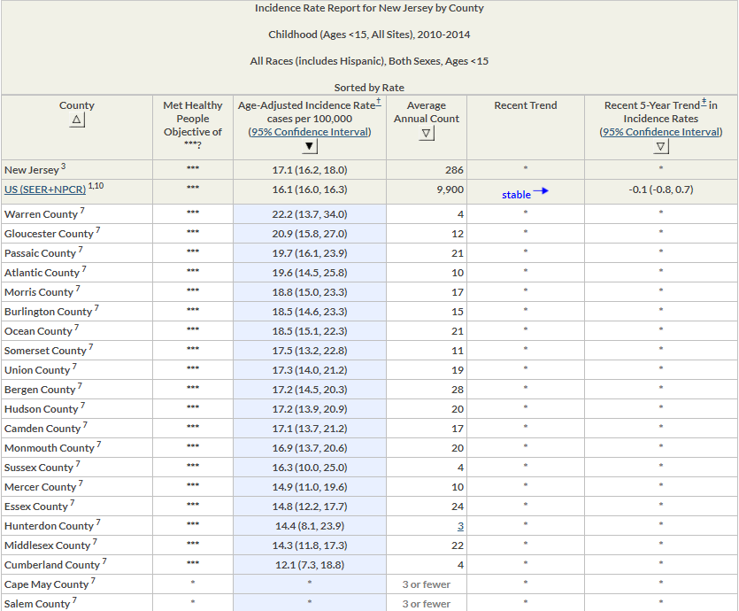
TMLTF:
Incidence Rates
Note: Monmouth County is Higher than the State and National Rate
CLUSTERS?
Ocean
Howell
Little Silver
Hazlet

Slide 12
TMLTF: Contact Info
The Mya Lin Terry Foundation
Post Office Box 249
Oakhurst, NJ 07755
Website: http://TheMyaLinTerryFoundation.org
Facebook: https://www.facebook.com/TheMyaLinTerryFoundation
Twitter: https://twitter.com/TMLT_Foundation
Kelly Terry, 732-861-9236, kellylynnterry@msn.com

Slide 13
MYA LIN TERRY

Slide 14
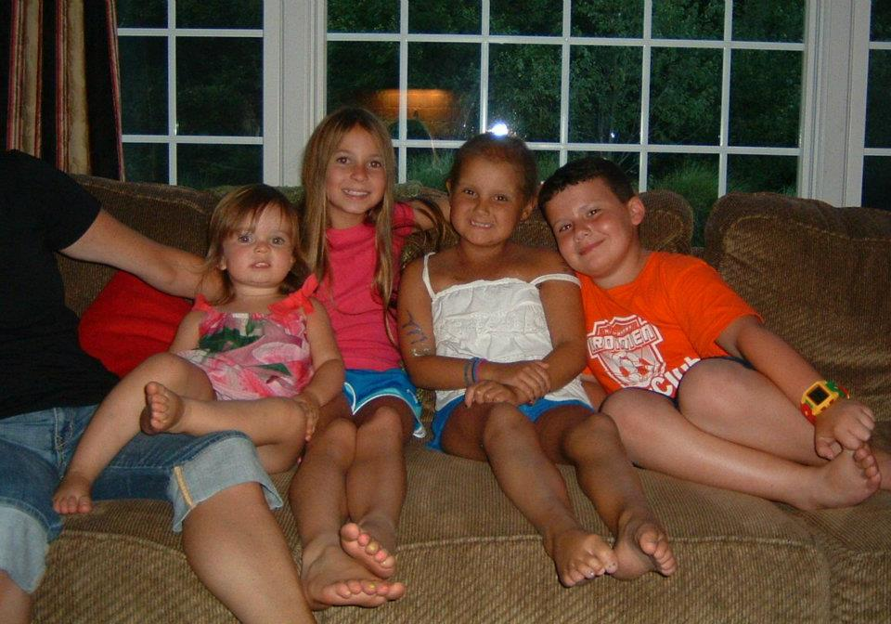

Slide 15
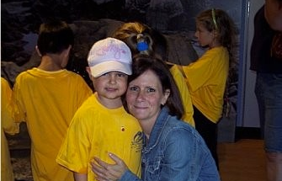

Slide 16
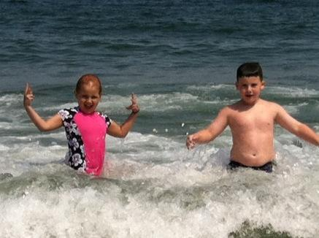

Slide 17
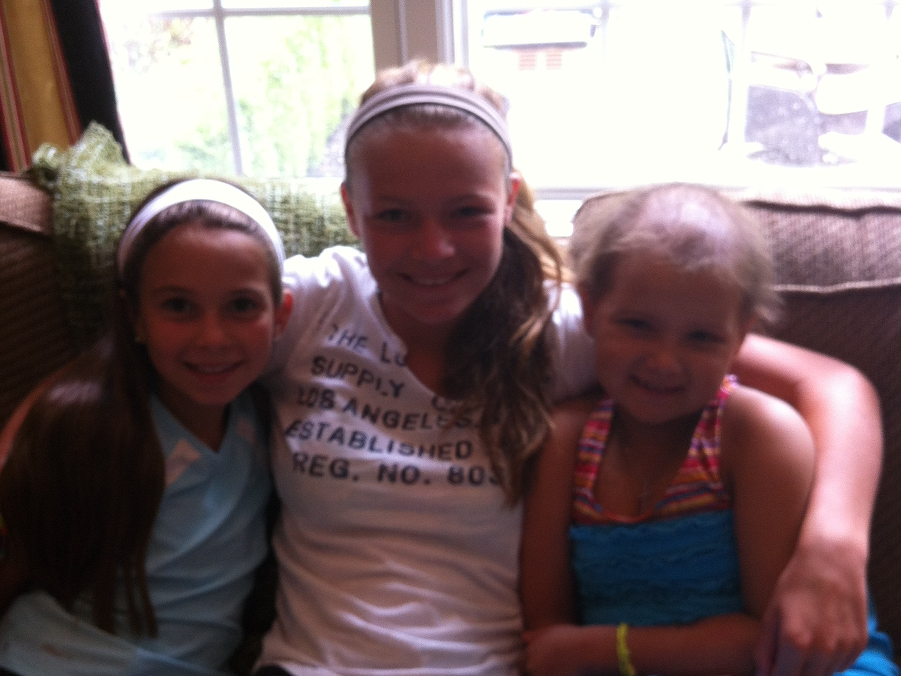

Slide 18
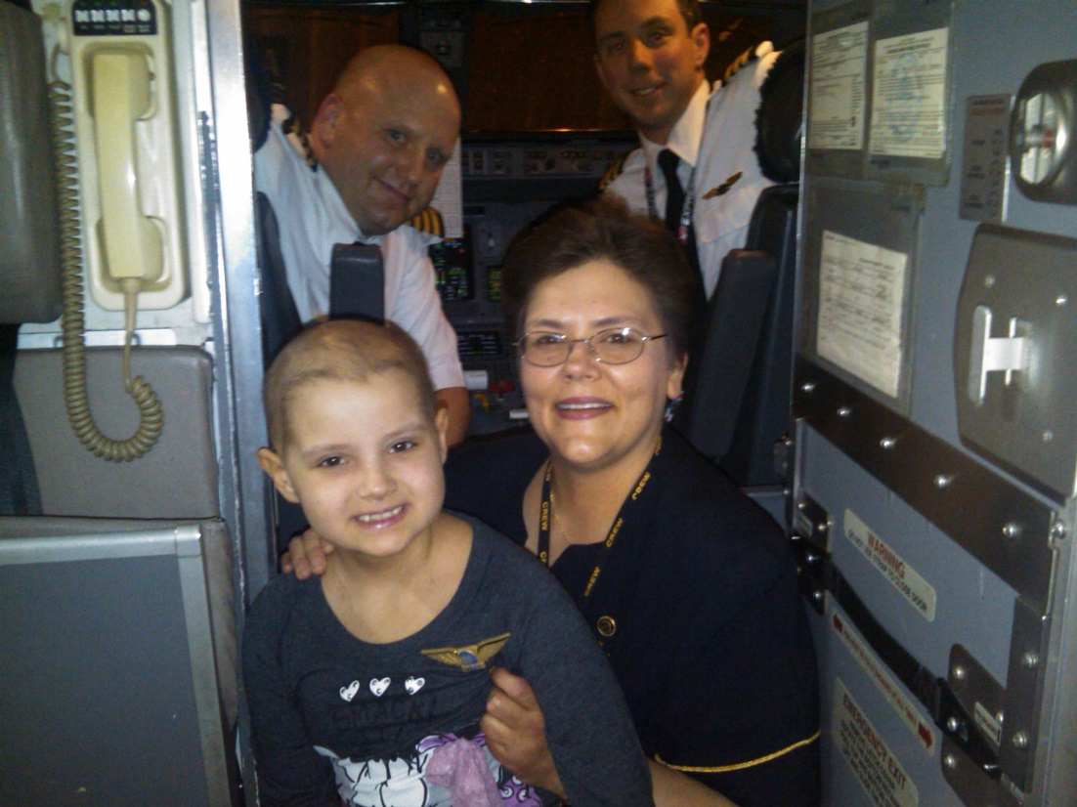
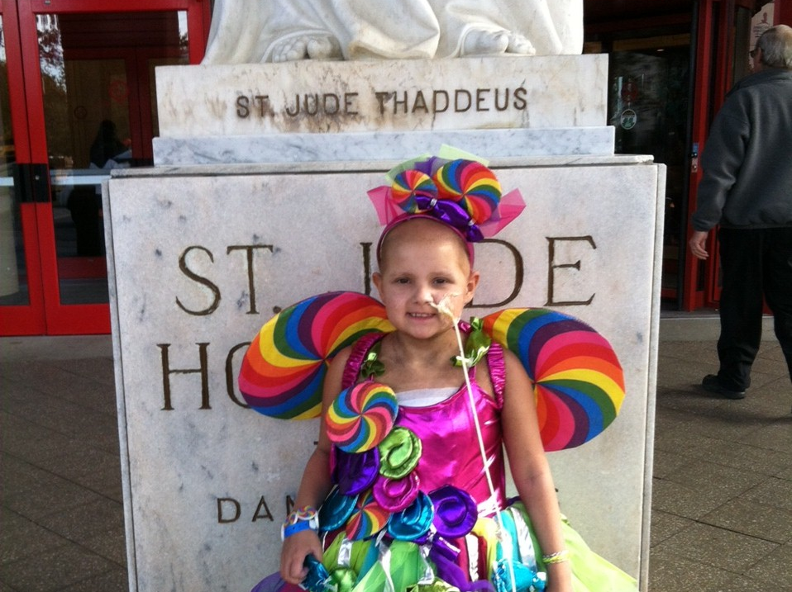
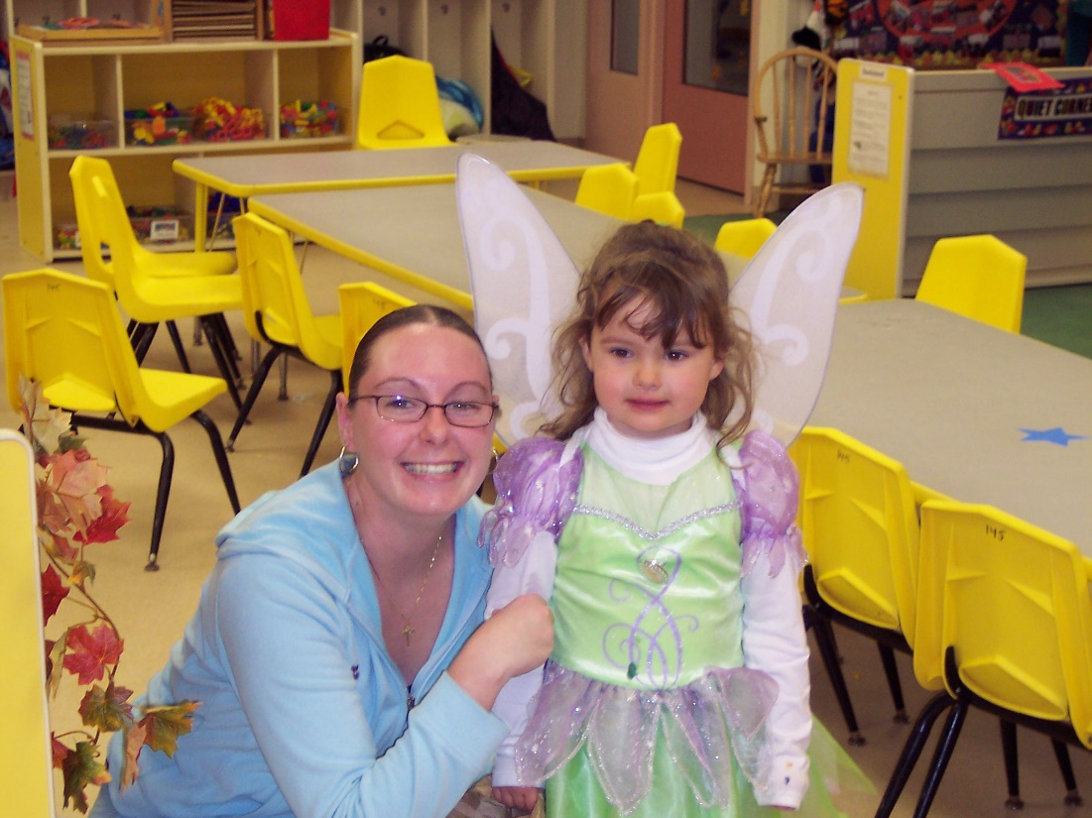
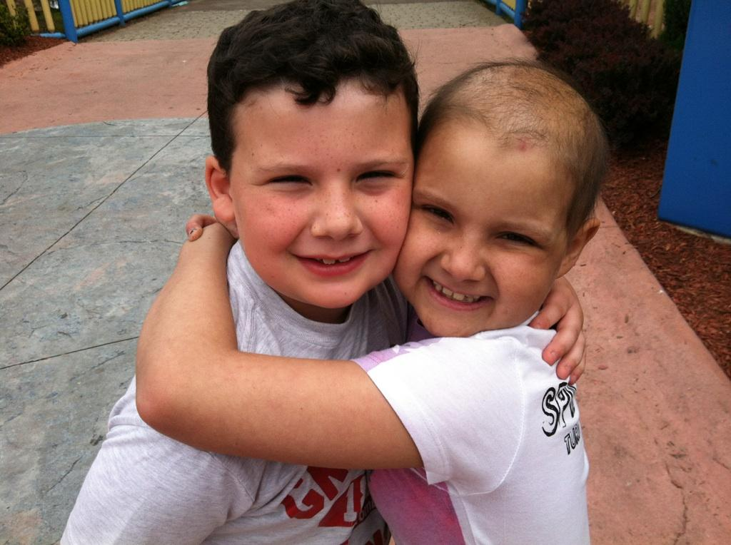

Slide 19
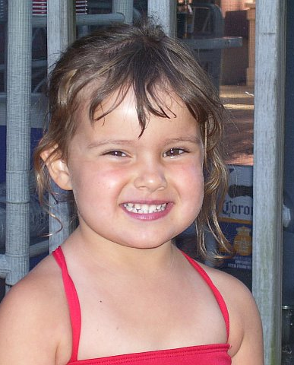
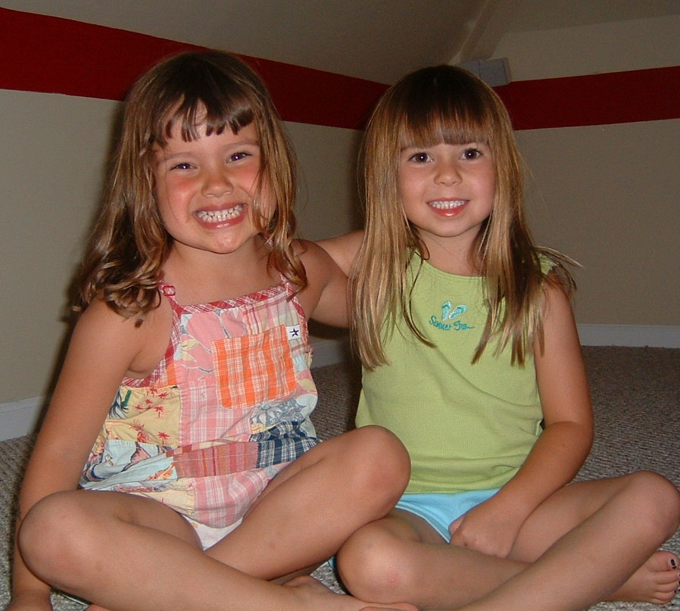
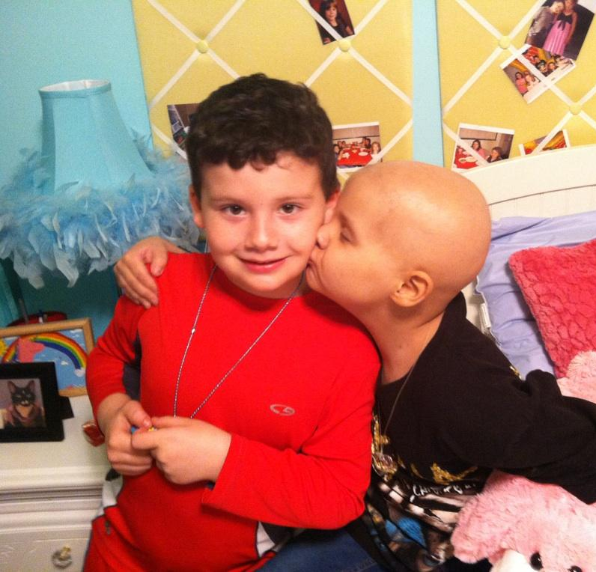

Slide 20
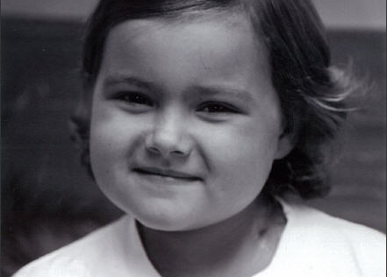
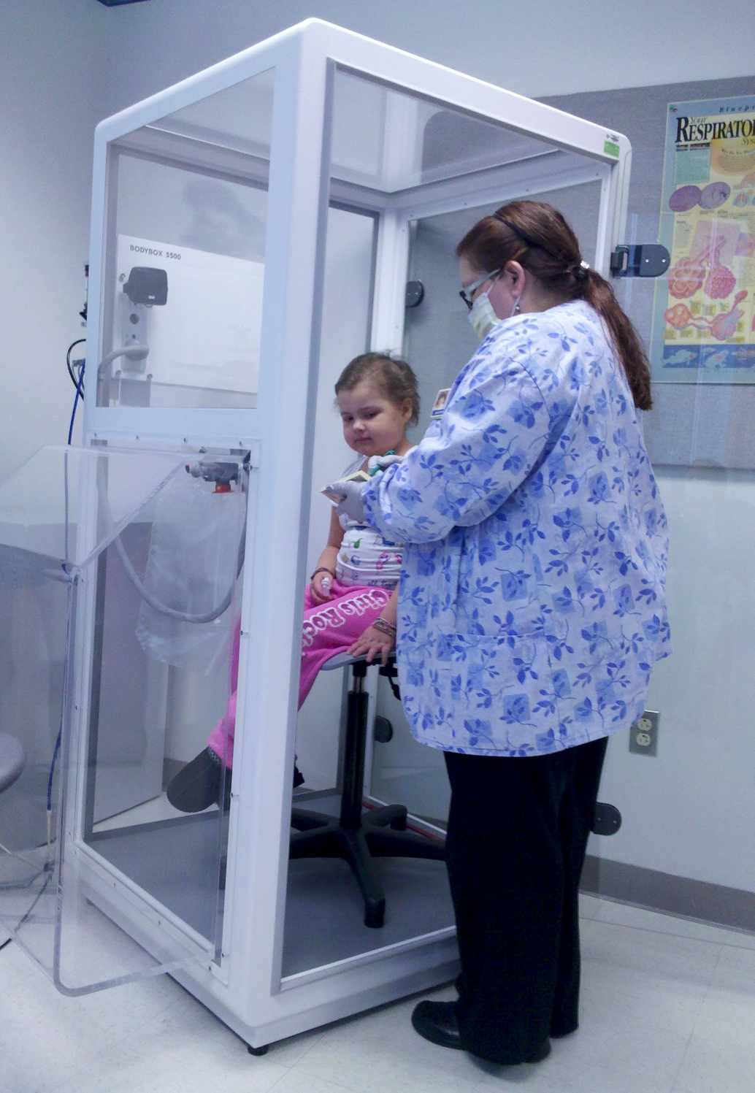
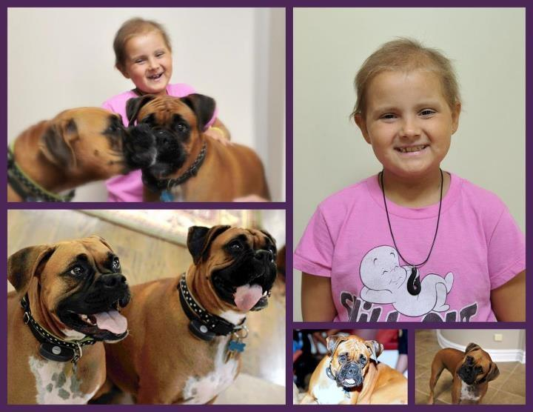

Slide 21
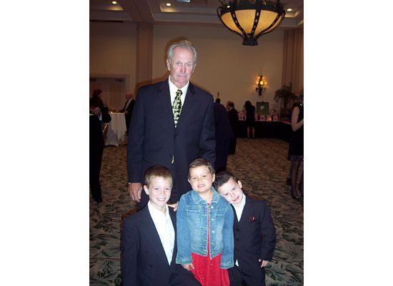

Slide 22
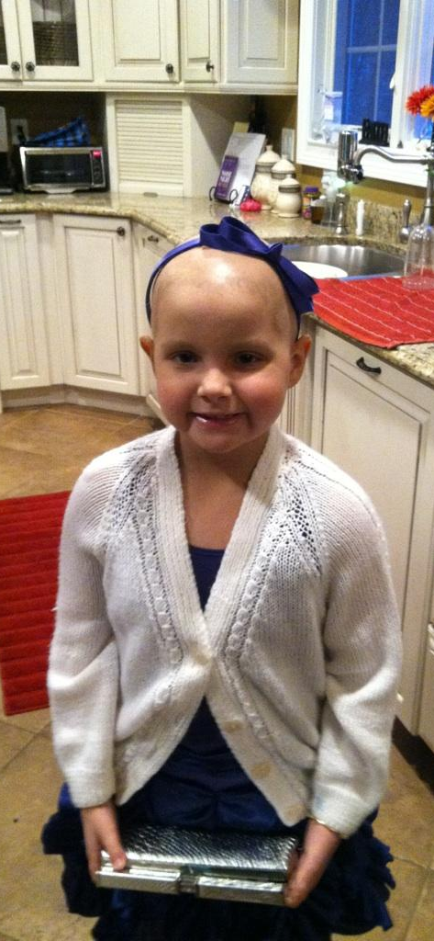
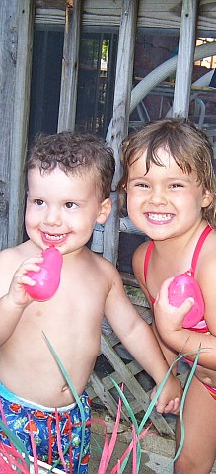
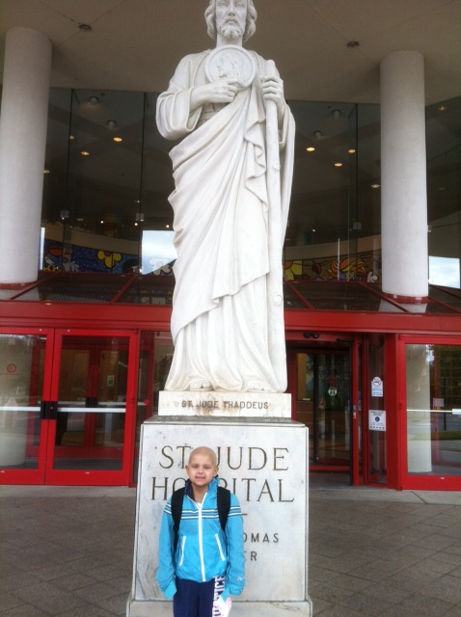

Slide 23


Slide 24
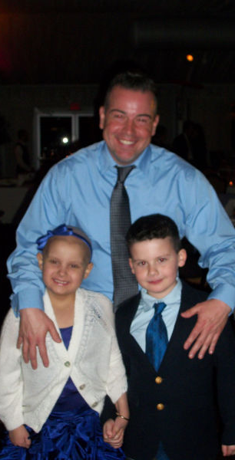
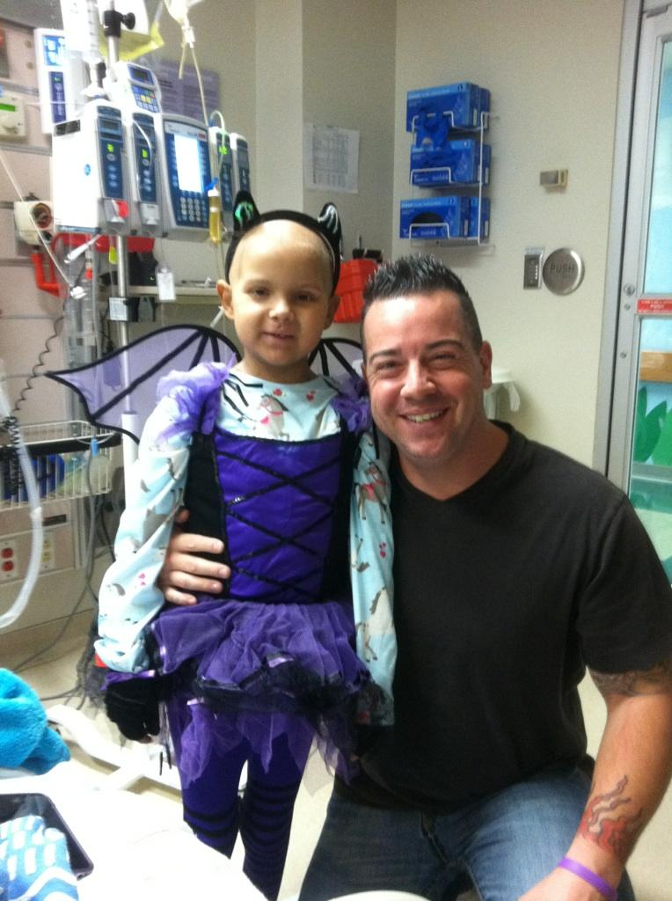

Slide 25
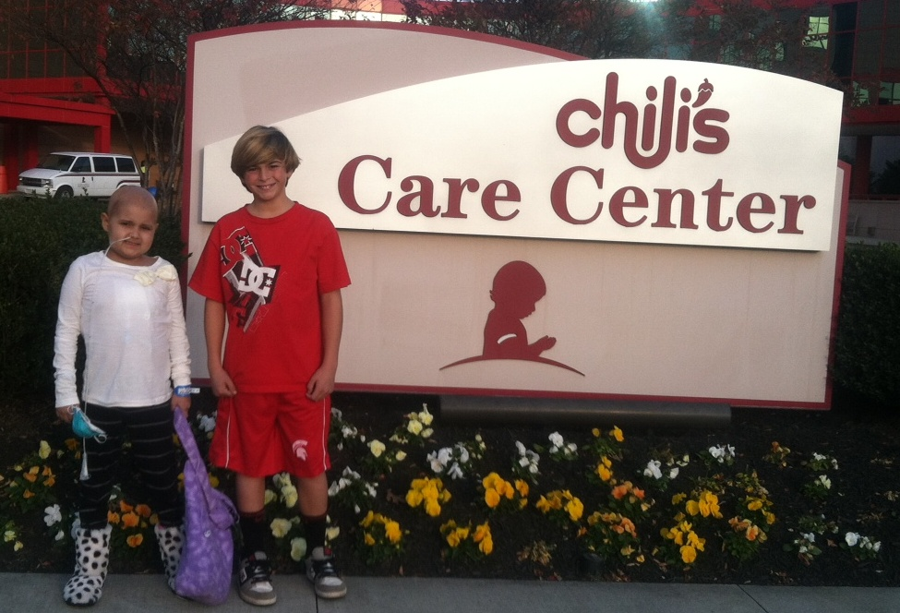
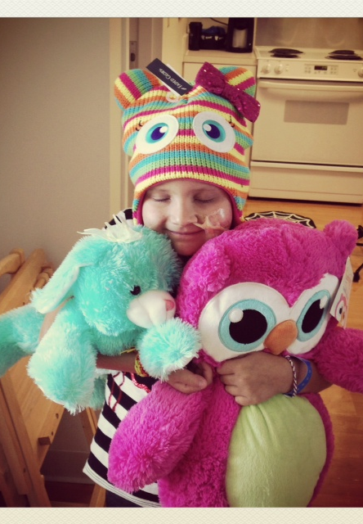
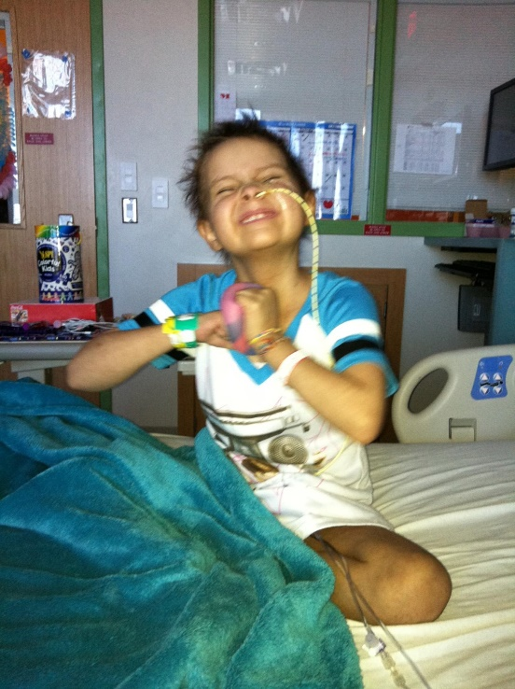
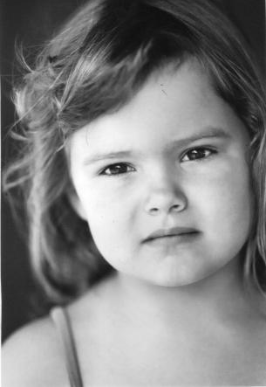

Slide 26
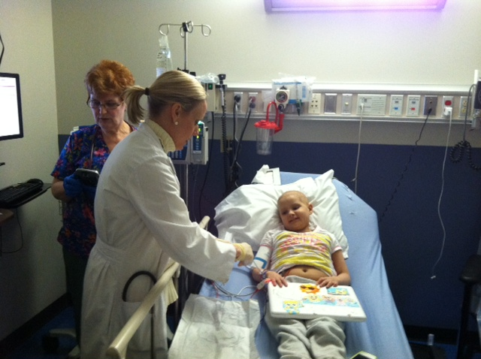
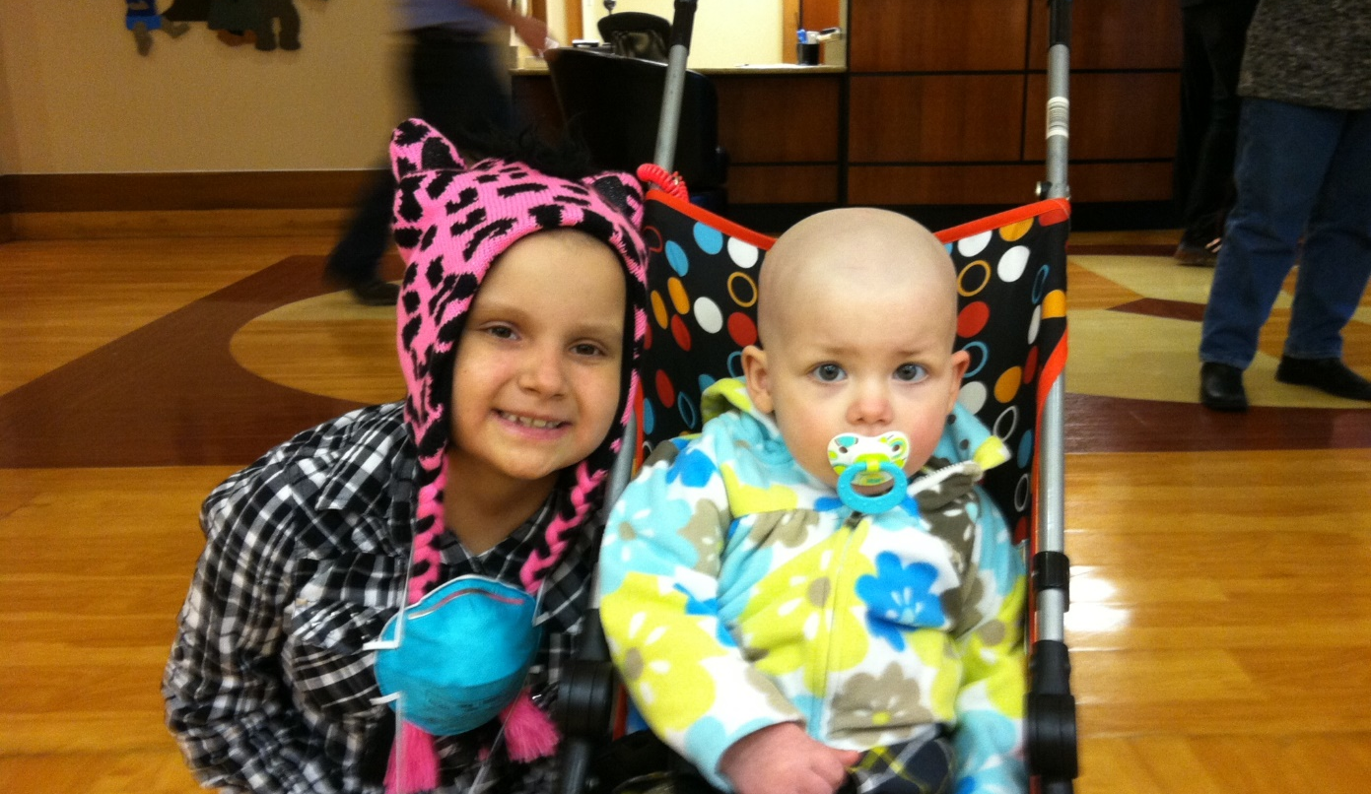
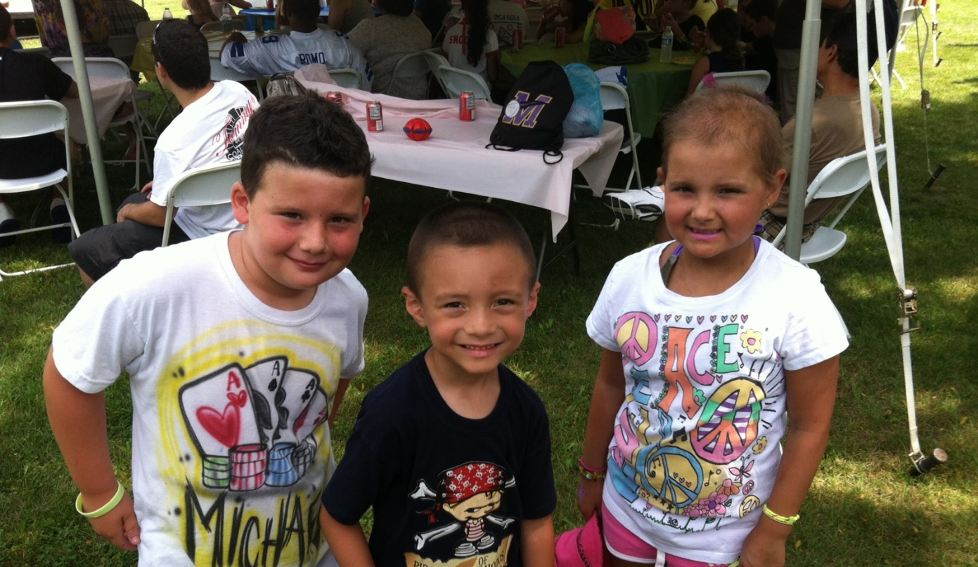
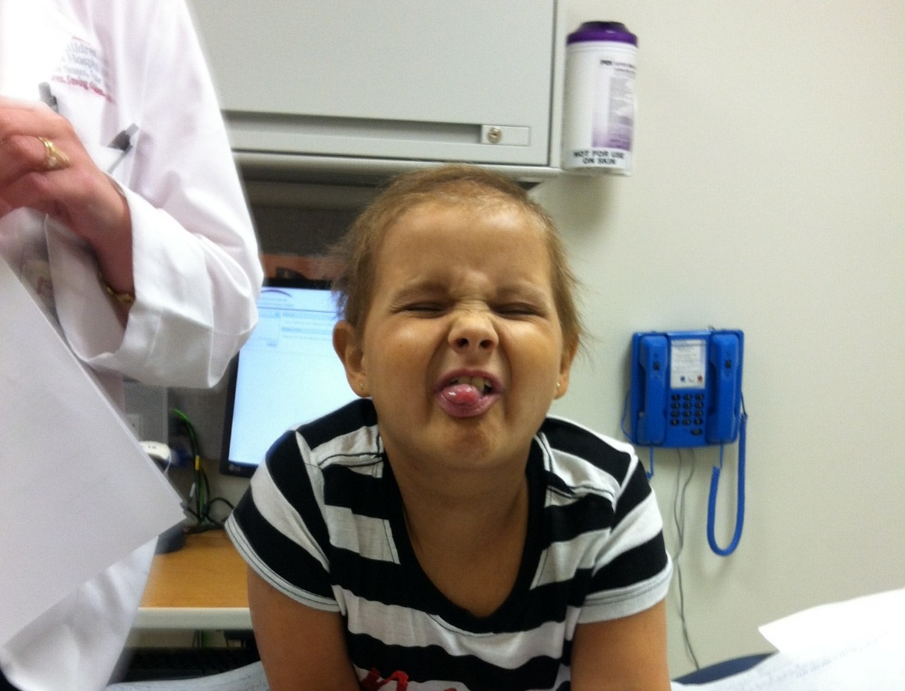

Slide 27
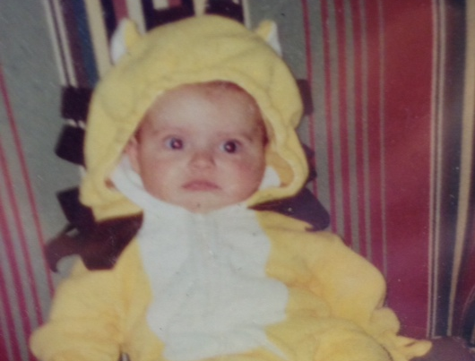
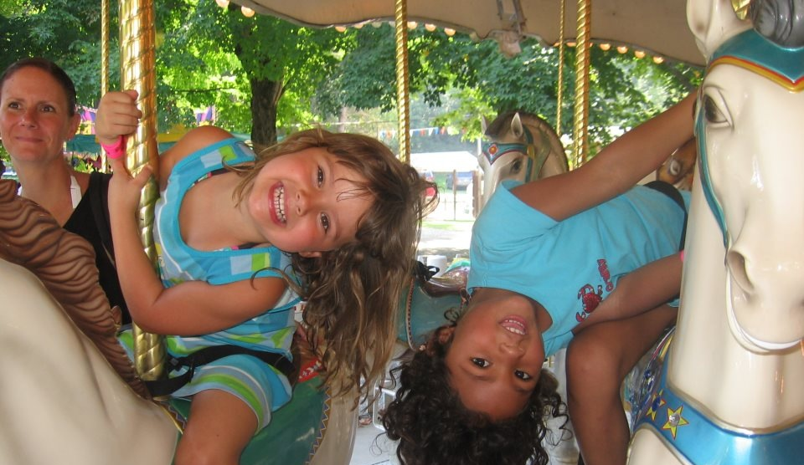
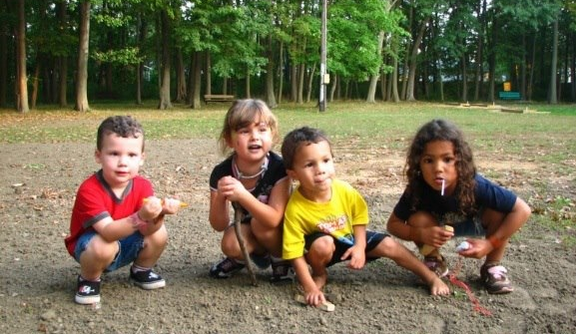
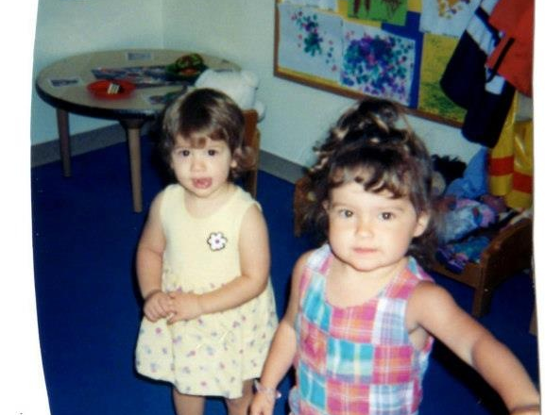

Slide 28
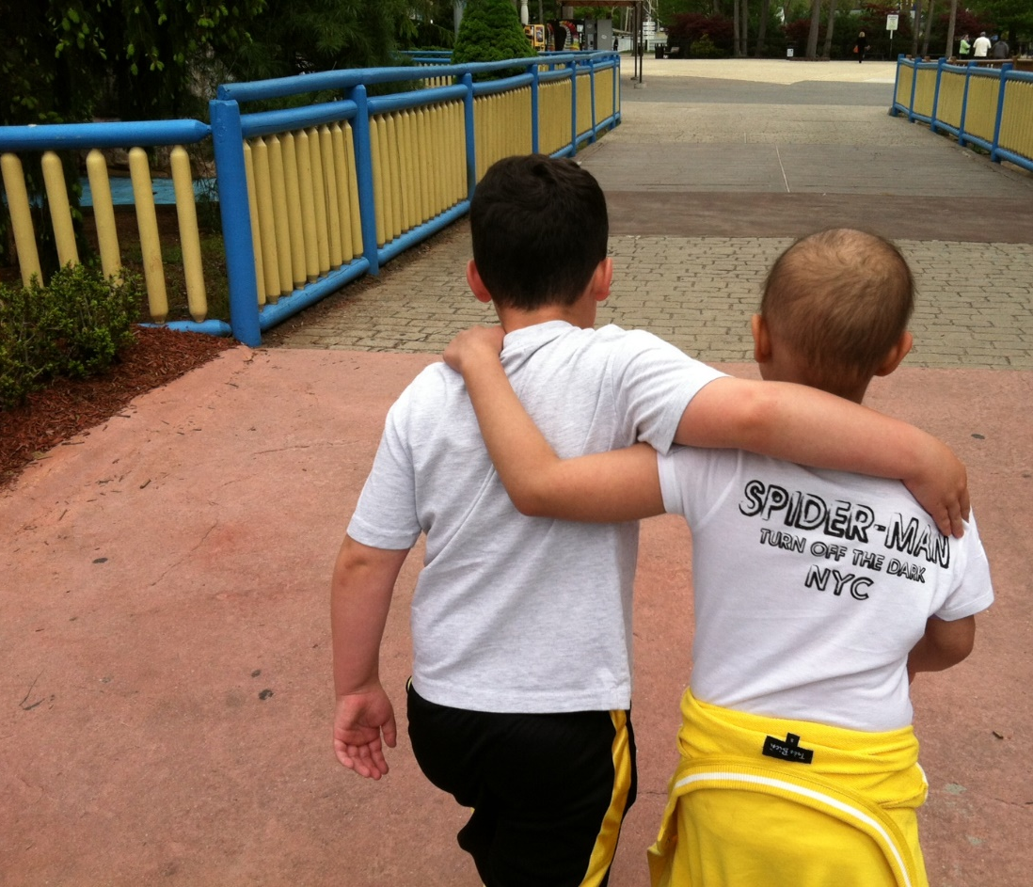
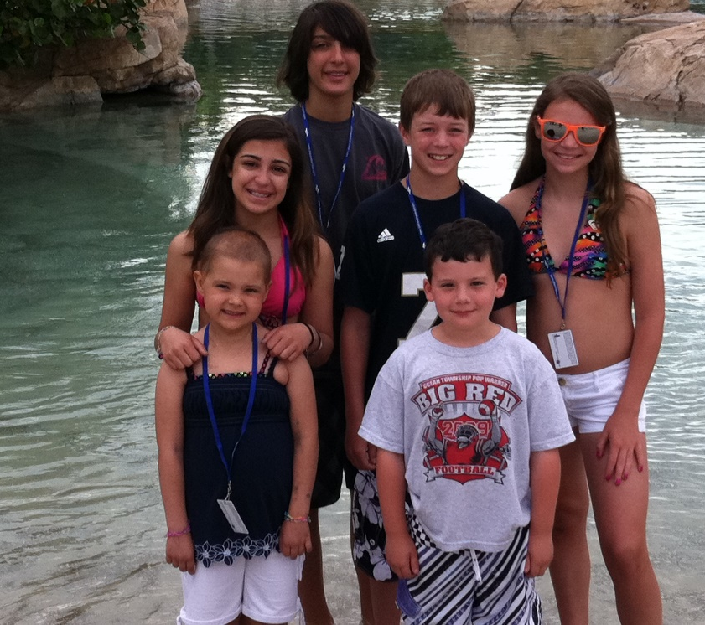
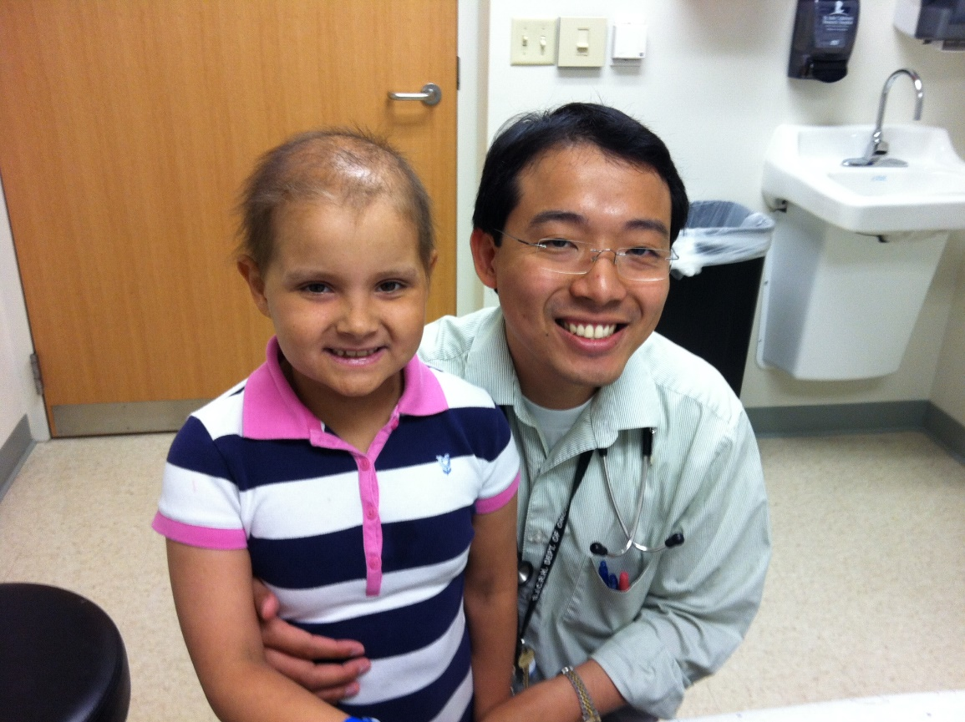
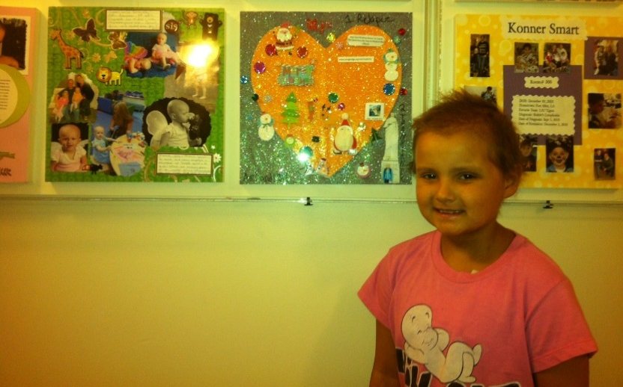

Slide 29
OUR WARRIORS AND ANGELS

